Slide 1

House Prices: Advanced Regression Techniques
Group 12
Chukwunonso Nnodum
Fred Mosoti

Slide 2
Situation Assessment
Brentford Real Estate wants to intensify it’s focus on improving the quality of potential homeowners due to reduction in sales.
We were challenged to predict the sales price of homes based on the most attractive house features that brought their previous clients.
Brentford Real Estate wants as to perform this task with the following objective in mind:
To increase quality homeowners and bias.
To increase their real estate ranking.
To assess support systems.

Slide 3
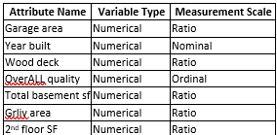
Data Preparation
The file has 1461 rows and 79 explanatory variables that describe every feature of a residential home in Ames, IOWA.
The dataset involves a mix of categorical and numerical variables.
Based on our target variable which is “Sale price”, we concluded of moving ahead with building a Decision Trees regression model for prediction of price of houses
Data Mining and Sorting
We were able to narrow down 7 house features by creating a features importance model, We believe this features play a crucial role to the pricing of the houses in Ames, IOWA.
Garage Area.
Total Basement SF
Wood Deck SF
Overall qual.
Year built.
Gr Liv Area ("Grade (above) Living Area")
2nd Floor SF.
The data was rearranged in various ways from the largest to the smallest and by grouping to find patterns that could help our analysis.

Slide 4

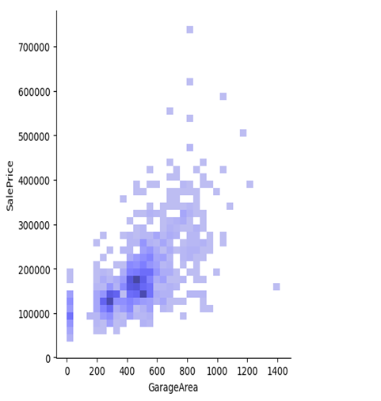
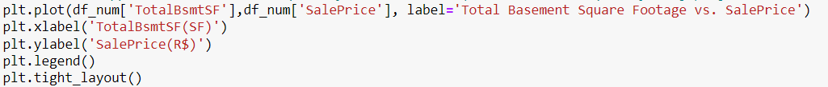
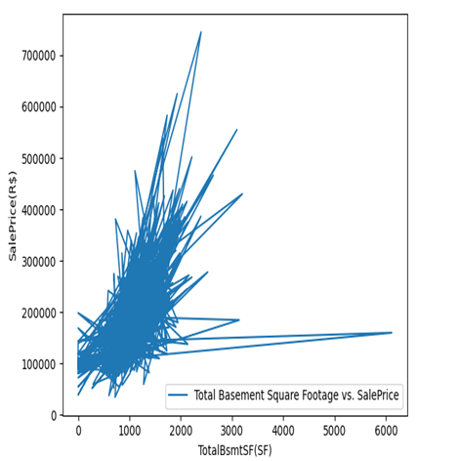
Data Cleaning
It was necessary to focus on replacing missing values of the dataset to reduce data redundancy, especially when dealing with numerical data
We compared salesprice to a random variable totalbasement which came to non-linearity.
We also compared Garage area to sale price and found a linear relationship

Slide 5
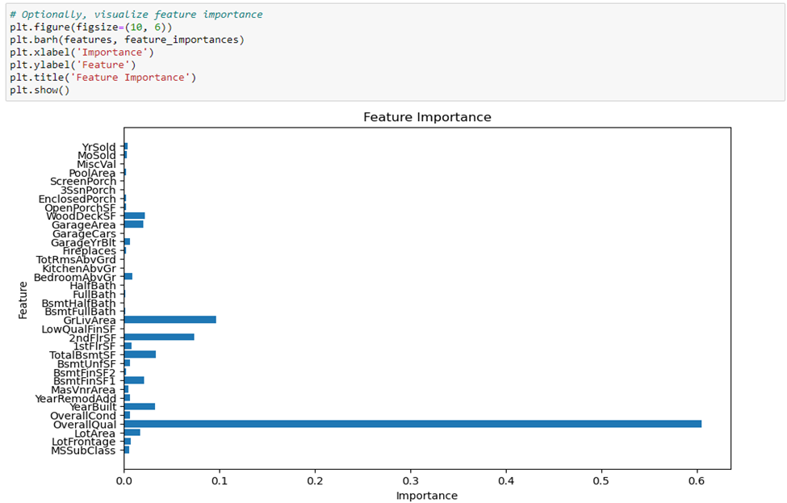

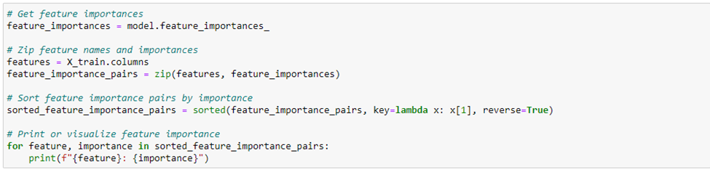
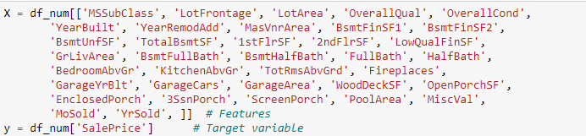
Feature Importance Model
We derived the specific features used in the Decision Tree from by applying all features into the features importance model.
The Features Importance table highlighted how important each feature is when determining sales price on a scale of 0-1, with Overall Quality feature taking a lion share of over 0.6(60%) importance.
We used the top 7 features as names earlier because we believe that these features significantly impact the sales price for each house.

Slide 6
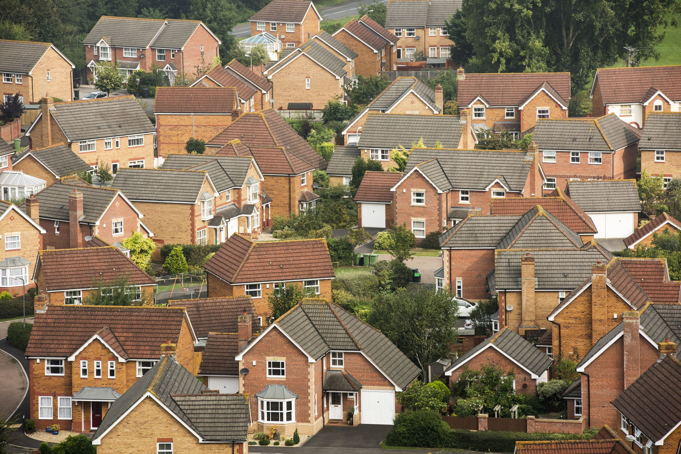
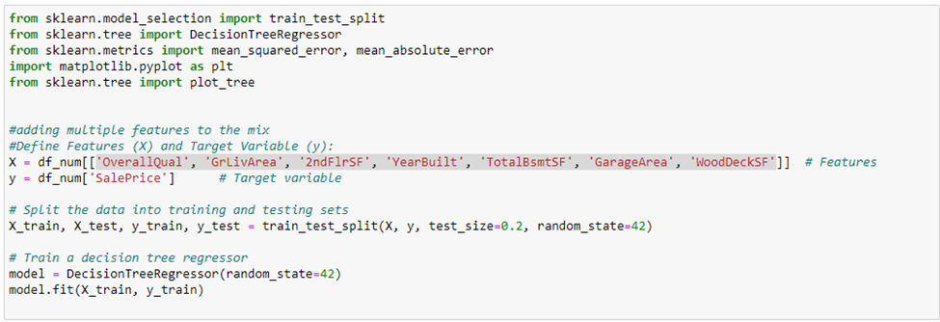

Detailed model development and output
For the Decision Tree:
Firstly, read the csv file in excel.
Sort the data set to make it more readable and understandable so that we can identify trends.
Identify important features that significantly affect Sale Price.
get the default tree.
Get the Accuracy, Mean Square and Absolute Errors.
Output:

Slide 7
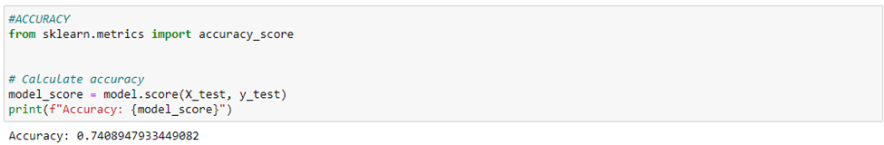
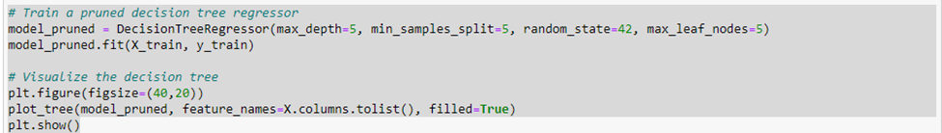
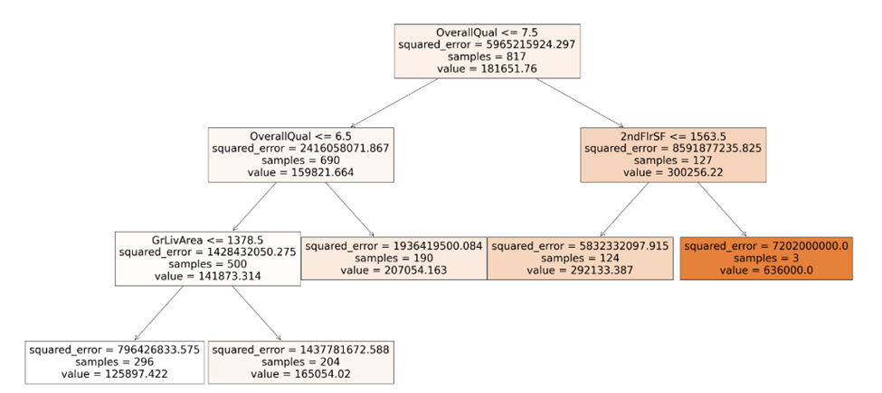
Decision Tree
We used the pruned tree because of its well detailed and summarized format for presentation and, also the default tree was not readable due to size
From the Decision tree, we got an accuracy of 0.7408947933449082 with a cut off of 0.8, this means the imprtant variables in the model correctly predicted the house price 74.09% of the time.

Slide 8
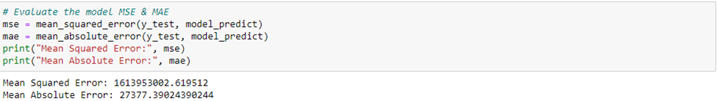
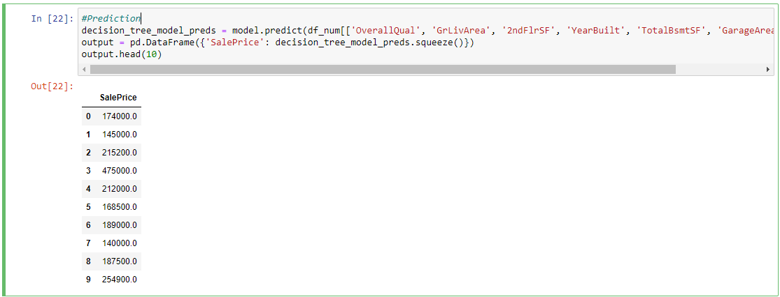
Model Evaluation
Model Limitation
Mean Square Error: with the squared difference of the predicted and actual price, an MSE of approximately $1.61 billion is fairly reasonable as it indicates the models predictions are actually closer to the actual price but a lower value is always a better indicator.
Mean Absolute Error: : In this case, an MAE of approximately 27,377 suggests that, on average, the absolute difference between the predicted and actual sales prices is around $27,377 which is also reasonable considering the metrics used but a lower difference between the predicted sales prices and the actual sales prices is always better
Data Integrity: Any model's ability to predict the future is dependent on the caliber of the training data. Predictions might be skewed by incomplete or inaccurate data and so there is always room for more testing.
Issues we might face when presenting results to Brentford Real Estate stakeholders
Preconceived notions based on the house prices
Overdependence of Historical Data
Disregarding less evident but significant aspects of the analysis due to easily assessable trends

Slide 9
How can we improve the model overtime
Establish a mechanism for obtaining input from house choices, features and results to update and enhance the model over time.
do fairness assessments to fix biases in the model in relation to the important features

